Slide 1

RENEWABLE ENERGY STANDARDS CERTIFICATION & MONITORING ORGANSATION
A Non-Profit NGO registered under Section 8 of Companies Act

Slide 2
ABOUT RESCMO

Slide 3
Overview
RESCMO is a non-profit organisation, registered under Section 8 of the Companies Act
It is focused on advancing renewable and green energy in India.
Established with a mission to enhance and promote the development of sustainable energy solutions.
RESCMO serves as a dedicated body for the monitoring, certification, and implementation of higher standards in the renewable energy sector.

Slide 4
Mission
We are committed to driving growth, innovation, and sustainability within the renewable energy industry by promoting research, developing new technologies, and setting standards for efficiency and environmental stewardship.

Slide 5
Aim
Through our efforts, we aim to create awareness of emerging renewable energy opportunities, educate stakeholders on sustainable practices, and ensure the responsible use of the planet’s finite natural resources.

Slide 6
Objectives
Promote the growth of renewable energy across India and internationally.
Support stakeholders in understanding & leveraging new technologies, innovations this segment.
Monitor the installation and effective utilisation of renewable energy resources, ensuring minimal wastage in usage.
Facilitate the creation of green jobs and enhance skill development through high-quality training programs.
Champion career development of green professionals, through education and participation.

Slide 7
Core Activities
Certification & Monitoring
Research & Innovation
Skill Development & Training
Expert-Led Training
Entrepreneur Training & Handholding
Training for Unskilled & Semi-skilled Staff
Policy Advocacy and Contributions

Slide 8
Core Activity
Certification & Monitoring
We plays an essential role in certifying and monitoring renewable energy initiatives, ensuring that both public and private investments in energy infrastructure are optimally utilised.
The organisation’s monitoring system ensures the effective use of resources, minimises waste, and supports the overall growth of the sector.

Slide 9
Core Activity
Research & Innovation
By promoting research and fostering innovation, we drive the evolution of renewable energy technologies.
We continuously pushes for higher standards of practice, enabling India to stay at the forefront of global renewable energy solutions.

Slide 10
Core Activity
Skill Development & Training
We place a strong emphasis on fostering the creation of green jobs and upskilling individuals to meet the ever-evolving demands of the renewable energy sector.
We are dedicated to developing a skilled workforce capable of addressing the complex needs of the industry.

Slide 11
Core Activity
Policy Advocacy and Contributions
We have actively contributed to shaping policies that support the growth of renewable energy and environmental sustainability in India.
We have been instrumental in framing important policies aimed at addressing critical issues in the renewable energy and environmental sectors.

Slide 12
Future Vision
RESCMO envisions a world where renewable energy is a primary source of power.
RESCMO will continue to set new benchmarks in energy standards, ensuring that India remains a key player in the global transition
RESCMO is dedicated to building a greener tomorrow by supporting innovation, education, and efficient energy usage.

Slide 13
Team RESCMO

Slide 14
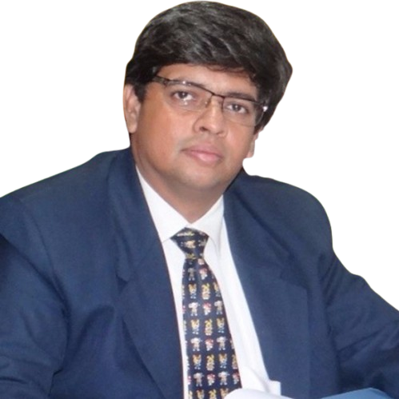
Team RESCMO
He is an entrepreneur with a strong focus on projects related to renewable energy and pharmaceutical sectors.
He is deeply committed collaborating with NGOs dedicated to enhancing technical knowledge and skills within communities.
His work empowers individuals to contribute to the renewable energy revolution, helping drive positive change and sustainable development.
Vaibhav Karkhanis

Slide 15
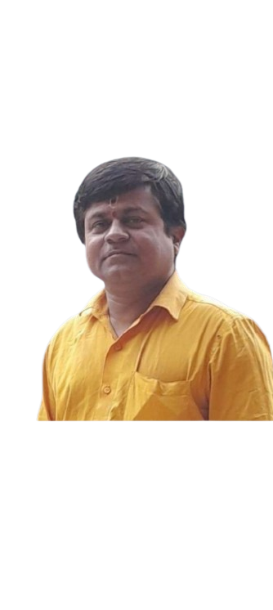
Team RESCMO
He is a results-driven professional with over 30 years of expertise in optimising operations, driving innovation, and delivering value to stakeholders..
He specialises in solar on-grid and off-grid solutions, leveraging his deep knowledge to create impactful strategies.
He brings extensive experience in CNC technology and the maintenance of complex Machines & Systems.
Manik Kulkarni

Slide 16
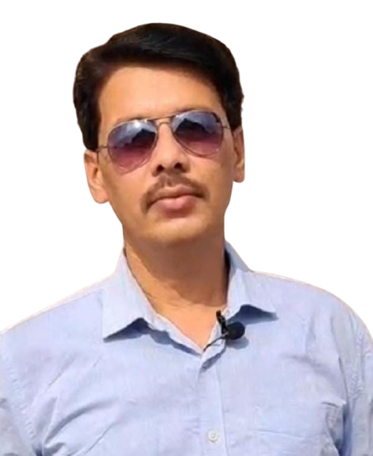
Team RESCMO
He is an accomplished Green Entrepreneur with over 12 years of expertise in both Solar Photovoltaic (PV) and Solar Thermal technologies. .
He has built a strong reputation for delivering high-quality, sustainable solar solutions
He is dedicated to empowering future entrepreneurs and semi-skilled professionals in the renewable energy sector through training programs.
Anand Prakash Tiwari

Slide 17
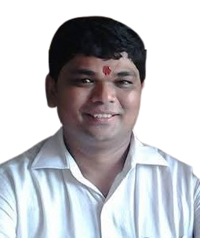
Team RESCMO
He is qualified a Chartered Accountant and Master in Financial Management.
He is expert in Financial Management and Project Consultancy in renewable energy projects.
He has a deep knowledge of various Government Schemes and their Financial Benefits related to the renewable energy sector
Brings his immense Knowledge of Banking to the team
Ashish Gupta

Slide 18

Team RESCMO
Compliance & Standards expert with 12 + years of experience in Solar Photovoltaics with expertise in PV modules, Inverters, Solar water pumps & lighting systems.
Vishnu Kumar

Slide 19
RESCMO activities

Slide 20
Carbon Credit Trading & Offset Credit Certification
India previously had limited policy frameworks for carbon credit trading and the issuance of carbon offset credit certificates
We facilitated discussions and consultations with key stakeholders, like Union Ministry of Renewable Energy, Union Ministry of Finance, and State Governments of Uttar Pradesh, Uttaranchal, Delhi, Gujarat, etc.
We helped develop and refine policy frameworks that enables a more robust and effective carbon credit trading system and the issuance of carbon offset credits

Slide 21
Policy on Stubble Burning in UP
Stubble burning has been a significant environmental challenge in India
We had worked closely with state government ministries like agriculture, industry, finance, and power also key bodies like UPNEDA, Uttar Pradesh Pollution Control Board, etc. and district administrations.
Through meetings and consultations, we contributed to the development of a policy framework designed to reduce pollution caused by stubble burning
The policy creates a balanced approach benefiting the agricultural sector, local communities, and business

Slide 22
RESCMO training activities

Slide 23
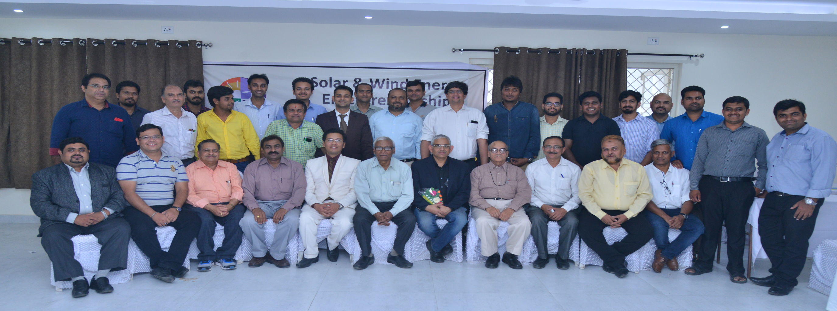
Entrepreneur Training - Nagpur

Slide 24
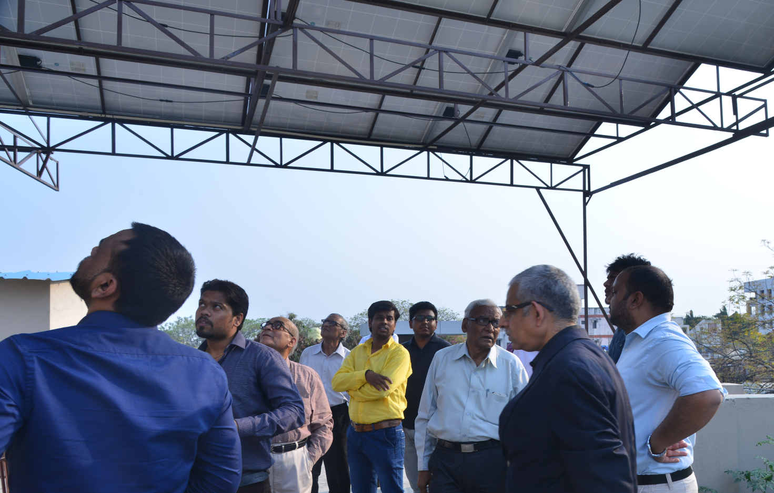
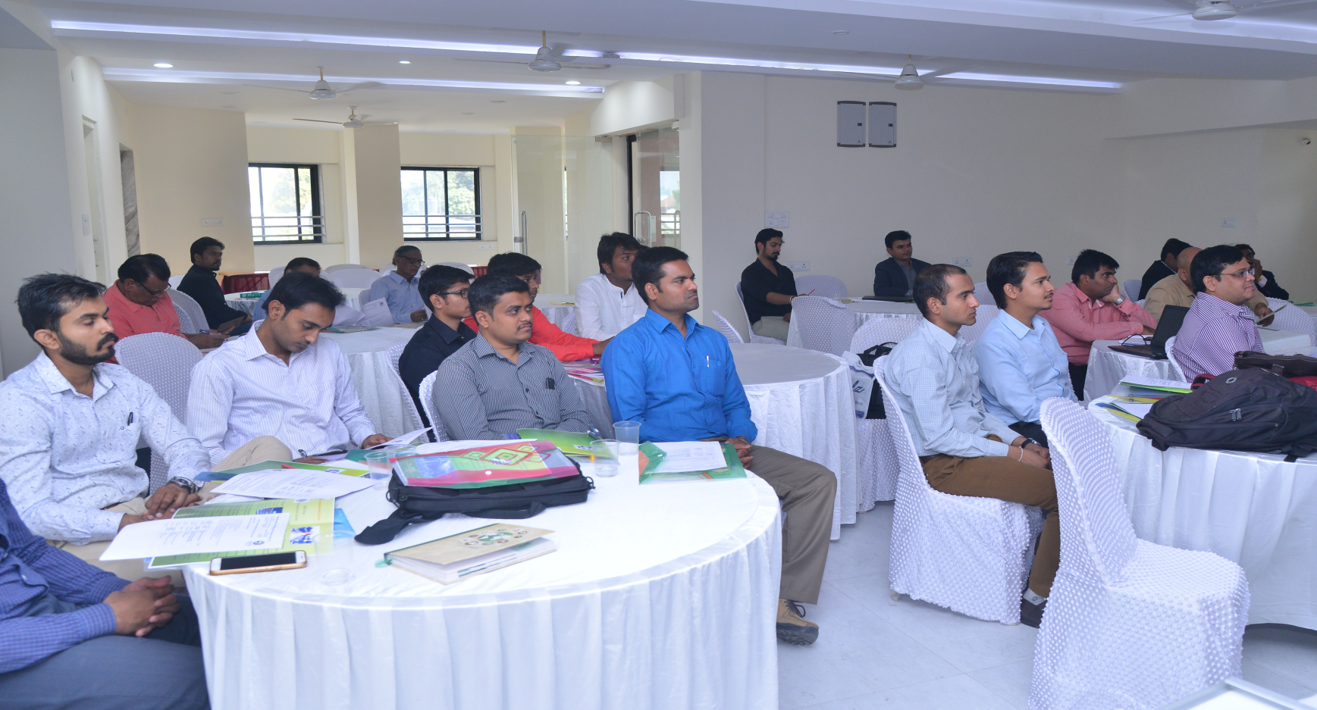
Entrepreneur Training - Nagpur

Slide 25
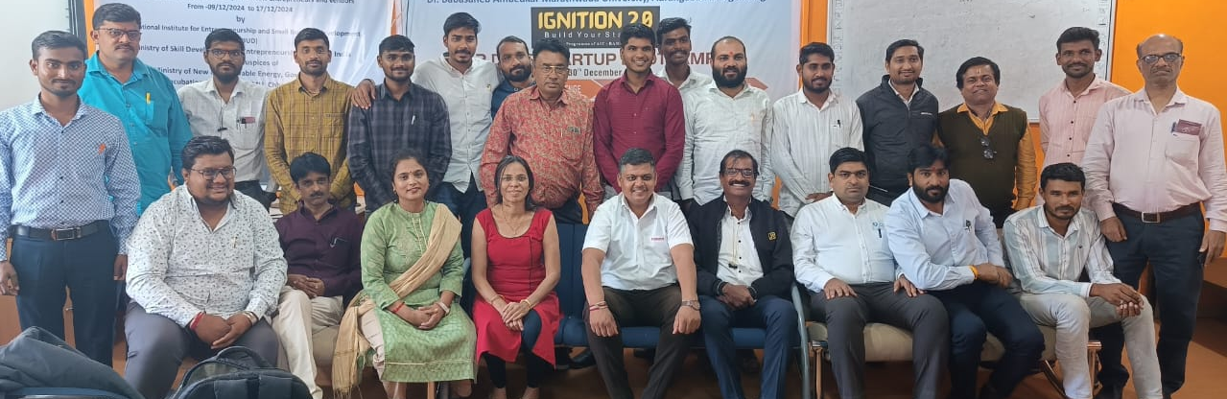
Entrepreneur Training - Aurangabad

Slide 26
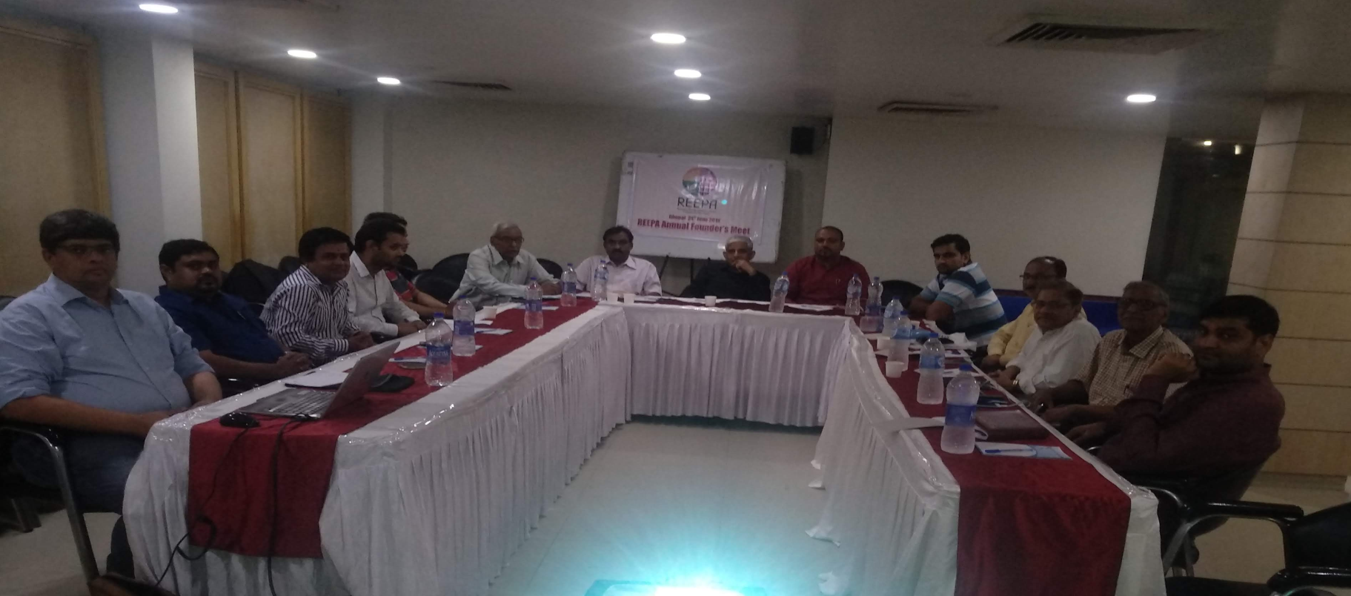
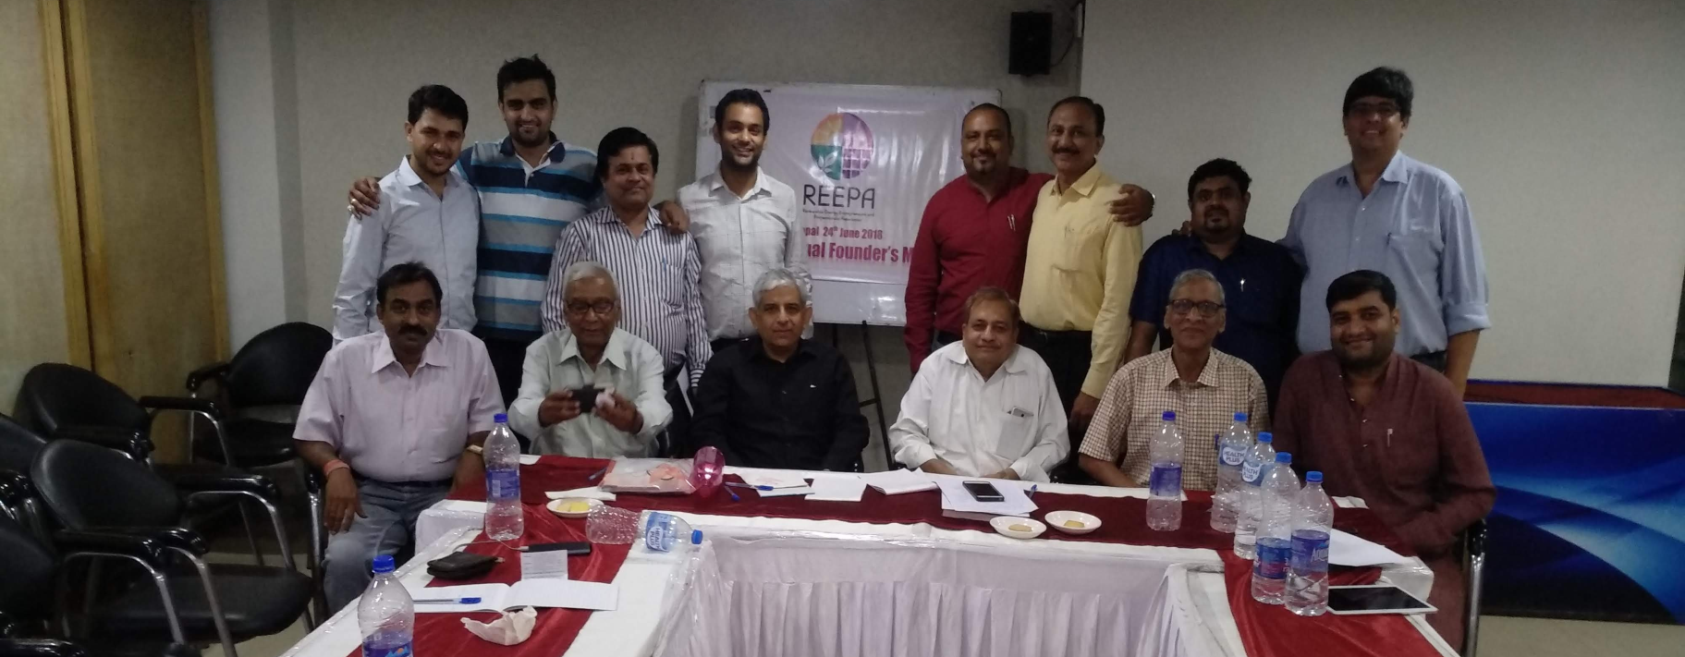
Training The Trainer Bhopal

Slide 27
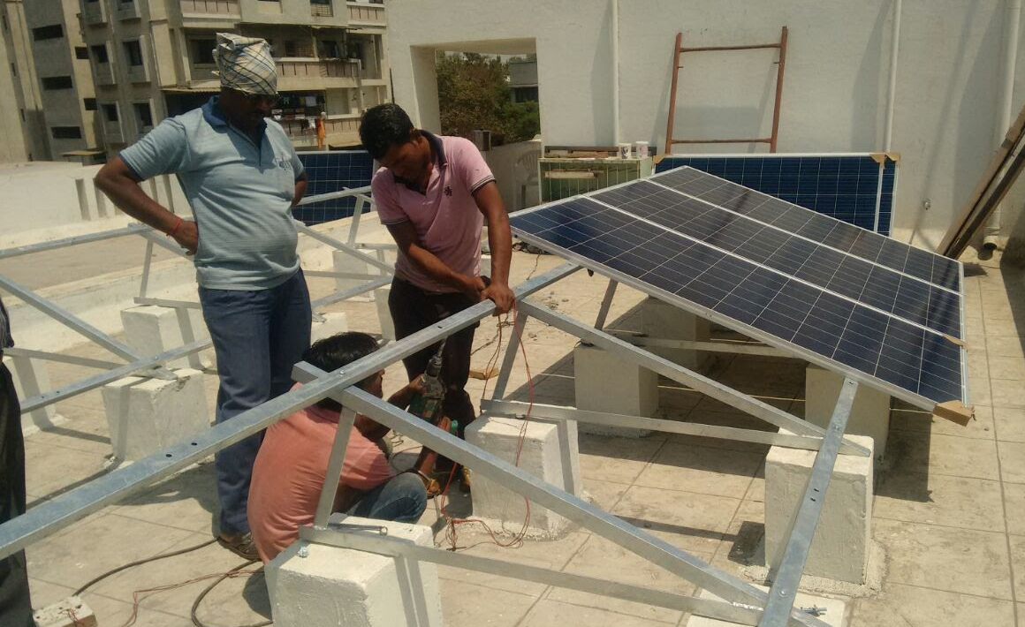
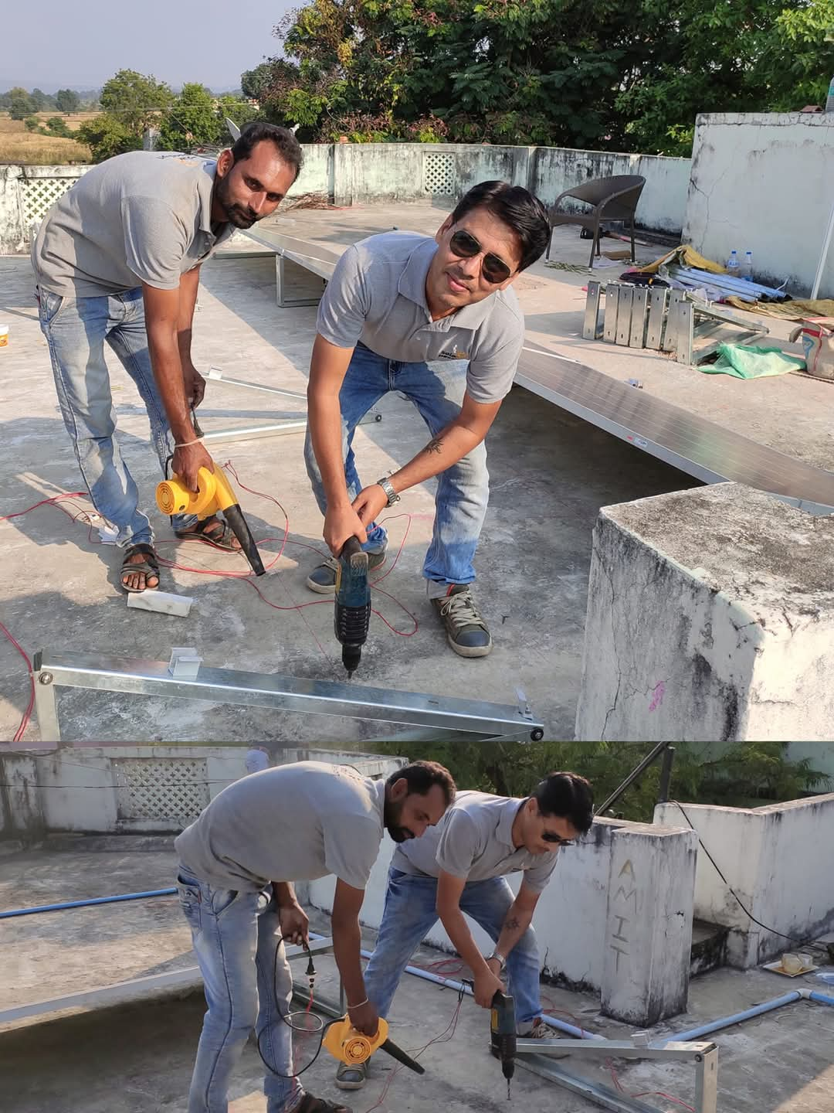
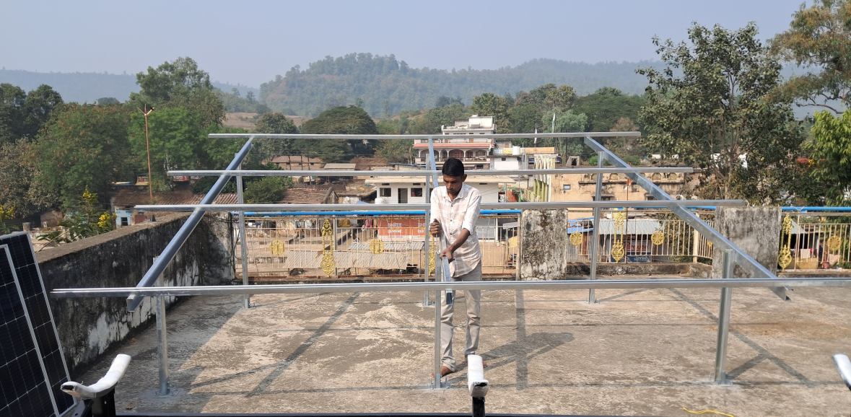
On-Field Staff Level Training Jabalpur

Slide 28

Network
Head Office
1404, Tower A, Gaur Atulyam, Sector-Omicron-1,
Greater Noida, Utter Pradesh
Regional Office
B1001, Harmony Horizon,
GB Road, Owala,
Thane, Mumbai 400615
www.rescmo.org
info@rescmo.org

Slide 29
RENEWABLE ENERGY STANDARDS CERTIFICATION & MONITORING ORGANSATION
A Non-Profit NGO registered under Section 8 of Companies Act

Slide 30



Entrepreneur Training Nagpur

Slide 31
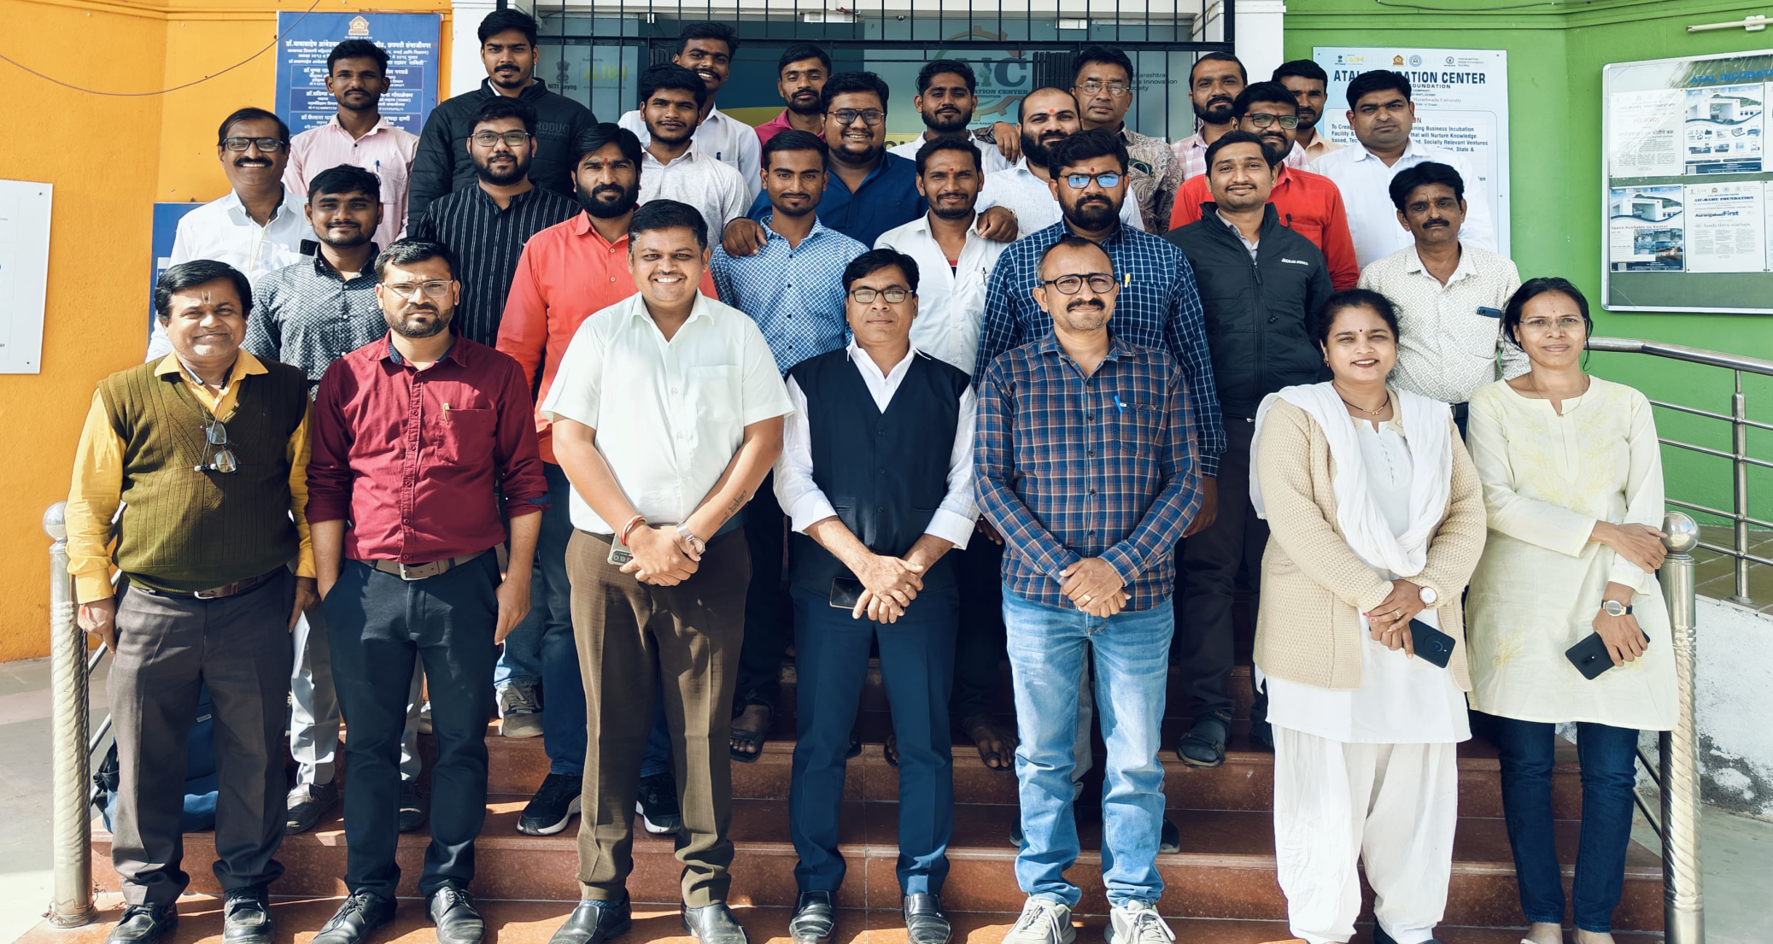
Entrepreneur Training Aurangabad

